Slide 1
Prediction of Termination by an Employee
CS-513 : Knowledge Discovery & Data Mining
Fall 2021
Professor - Khasha Dehnad
Presented by: Group 3

Slide 2
Team Members :
Aditya Shivankar - 10472887
Devendra K Chauhan - 10473877
Devika Mhatre - 10467698
Sudarshana Sarma - 10469063

Slide 3
Agenda :
Introduction
Roadmap
Dataset Description
Exploratory Data Analysis
Data Preprocessing
Models
Comparison
Conclusion

Slide 4
Introduction

Slide 5
Overview :
Every year, many employees terminate a organization based on numerous factors. We strongly believe that what we have learn in KDD can be used to analyse the data and predict
Employee termination varies widely from employee to employee, and a deep understanding of various factors helps to predict the number of employees terminating
Many factors contribute when employee wanted to terminate a company like including age, job satisfaction, hourly rate as well as performance rating
The previous five years rating is an important factor in deciding the number of employees being terminated as rating is directly proportional to annual rate
Goal: This project predicts the number of an employee terminating a organization in a year based on various characteristics such as age, job satisfaction

Slide 6
Road Map :
Understanding of Problem
Data Mining
Data Cleaning
Compare model Accuracy
Test different classifications
Algorithm Selection
Best Model selection

Slide 7
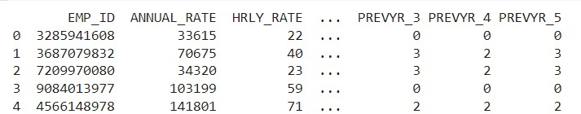
Dataset Description :
The dataset contains almost 10,000 data entries of the employee till the year of 2017 and prior.
The dataset consists of 1 file as mentioned below which contain 27 column:
attrition_data.csv

Slide 8
Exploratory Data Analysis

Slide 9
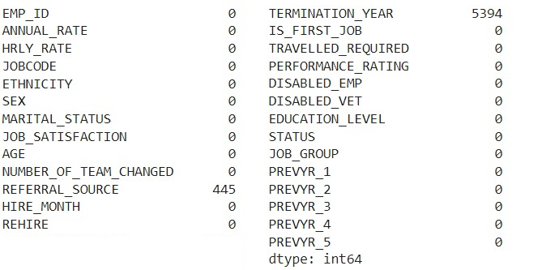
Exploratory Data Analysis :
Data Cleaning

Slide 10
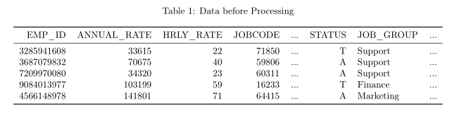
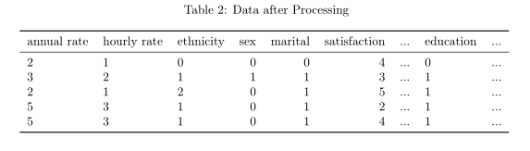
Data Preprocessing :
Initial data features columns including annual and hourly rates, ethnicity, age, sex, job group, first job, education level.
Columns employee id, termination year, job code, and referral source are removed because they have missing data.
Status, whether kept or terminated, is selected as the target column and factorized.
Some features were factored:
Annual rate is split based on $20,000, $50,000, $75,000, $100,000, and $2,000,000.
Hourly rate is split based on $25, $50, $75, $100, and $1000
Age was split based on 20, 30, 50, 60, 100.
Hire month was split based on months in Q1, Q2, Q3, and Q4
Ethnicity, sex, martial status, number of teams, first job, travel requirement, disabled, veteran, job group, and education were factorized

Slide 11
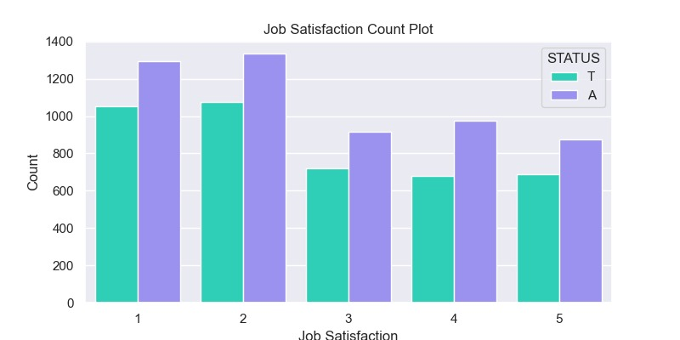
Job Satisfaction Count Plot :

Slide 12
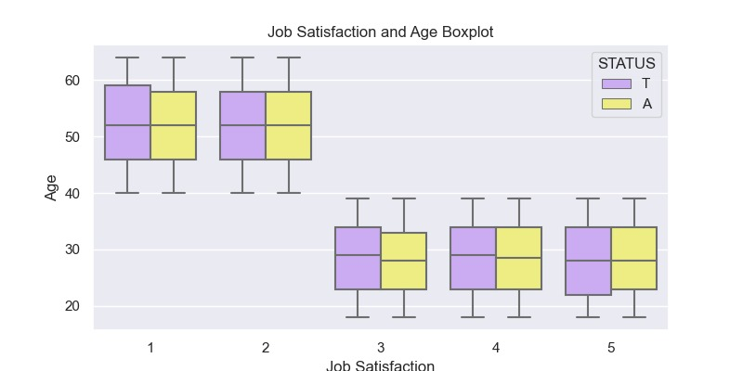
Job Satisfaction and Age Boxplot :

Slide 13
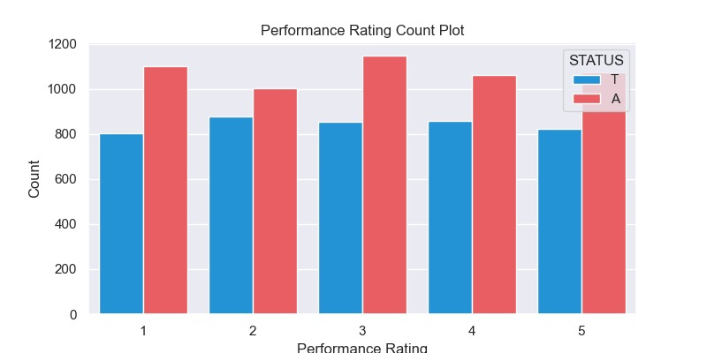
Performance Rating Count Plot :

Slide 14
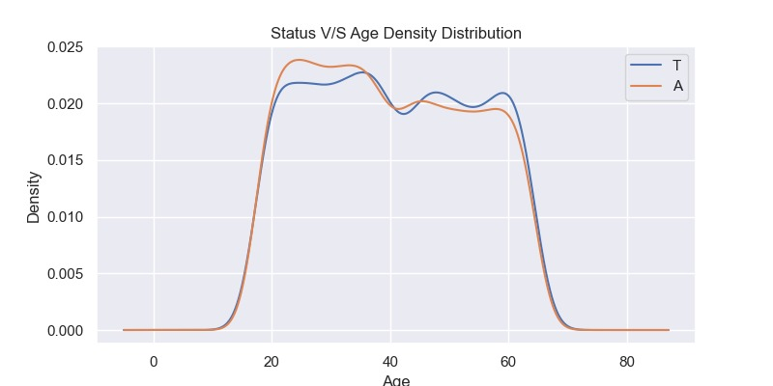
Status V/S Age Density Distribution :

Slide 15
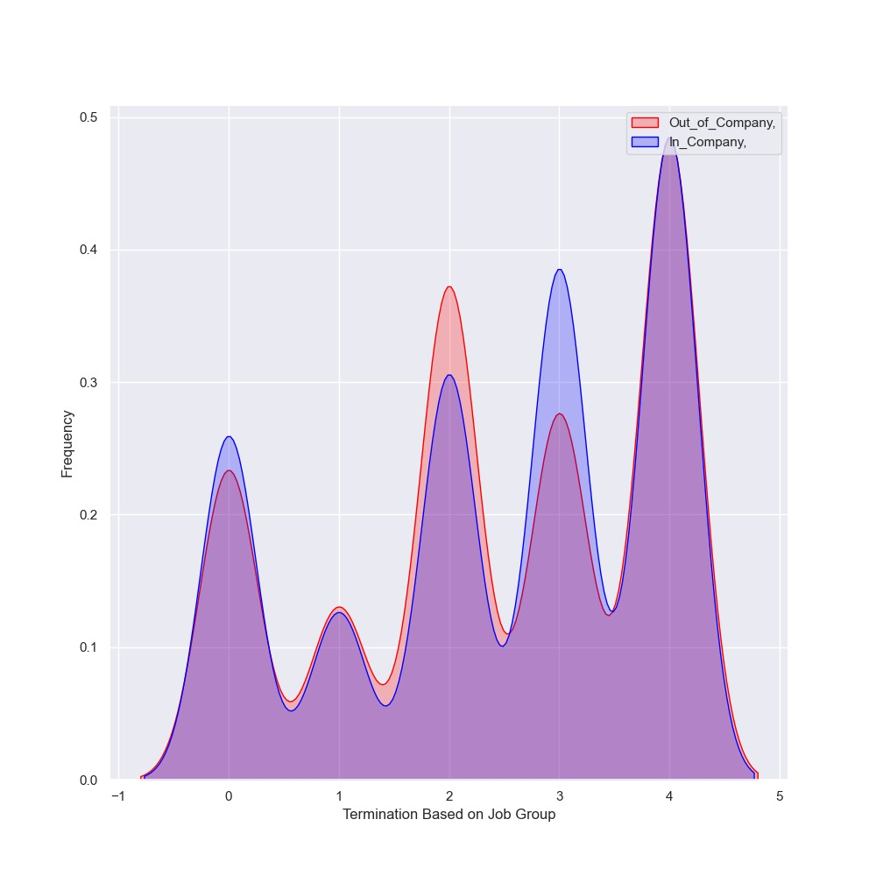
Termination based on job group :

Slide 16
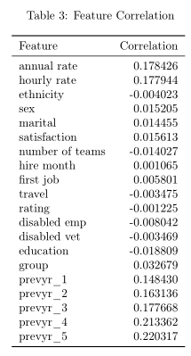
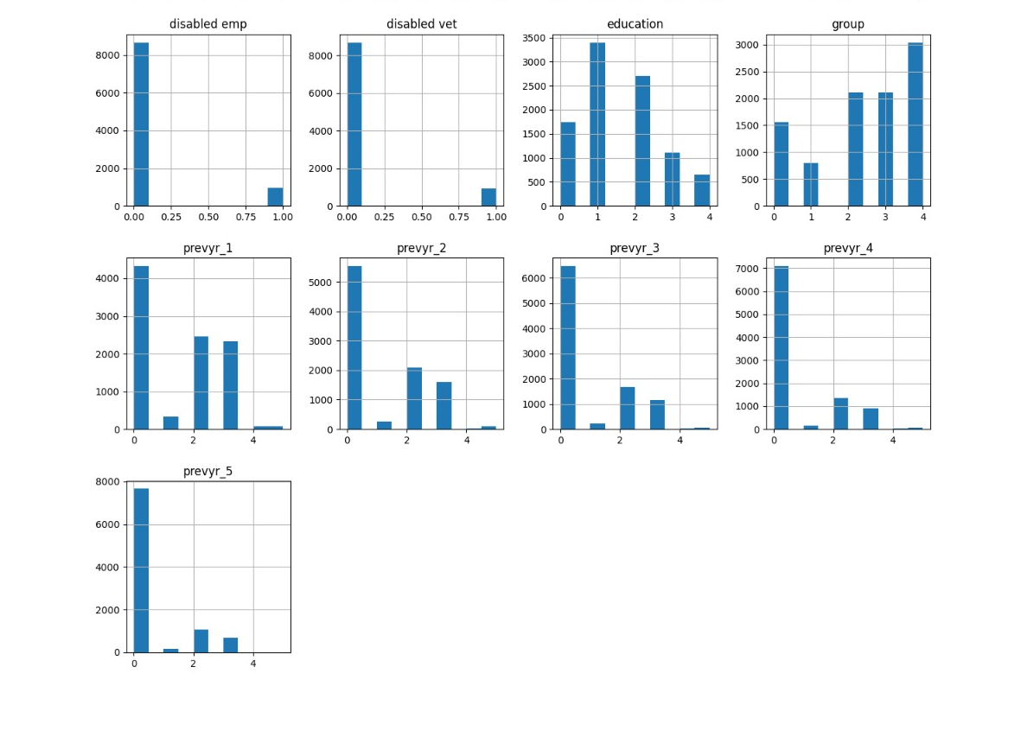
Exploration of Data :
Examining the correlation between the different features and the status (target) of the employee.

Slide 17
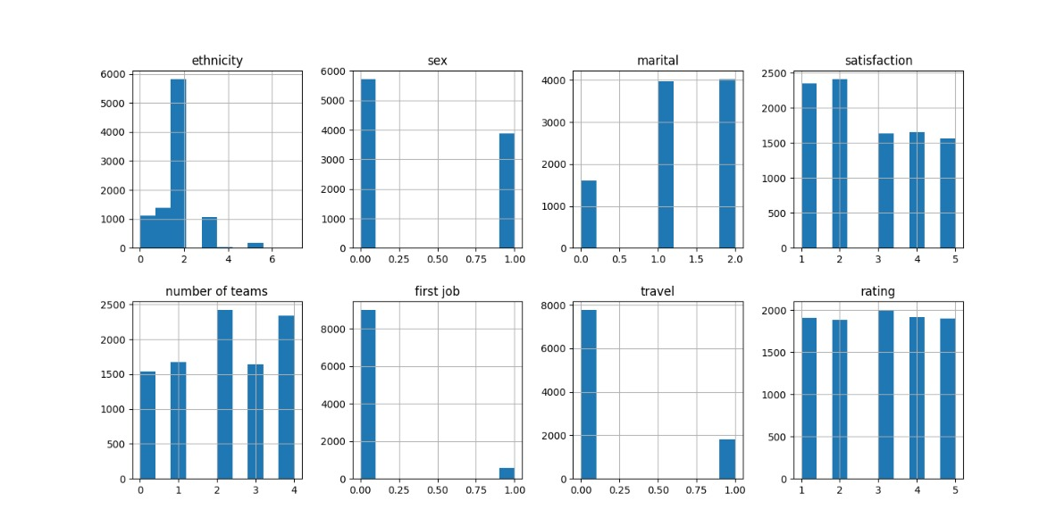
Exploration of Data :

Slide 18
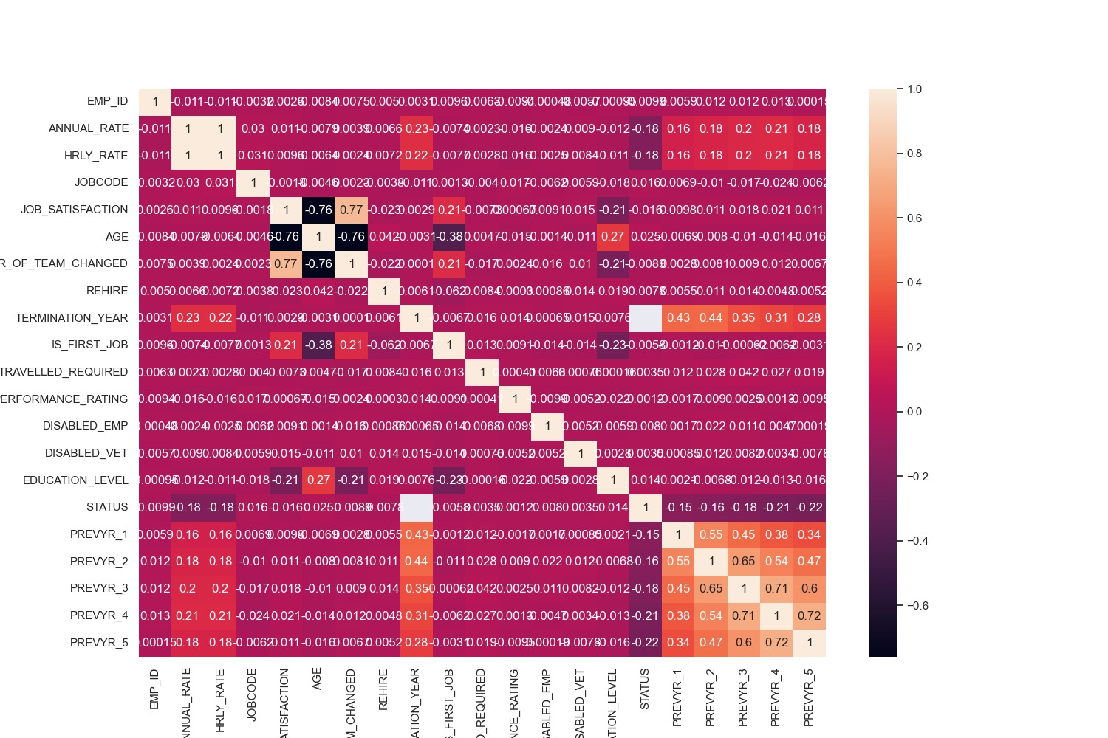
Feature engineering - Correlation heatmap :

Slide 19
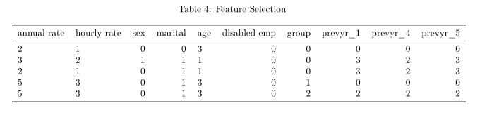
Preparing for Modeling :
The data was split into 70% training and 30% test subsects.

Slide 20
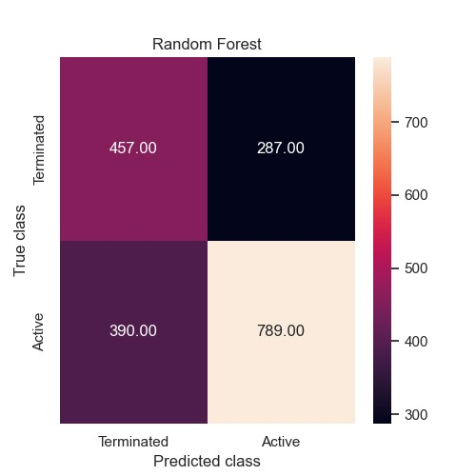
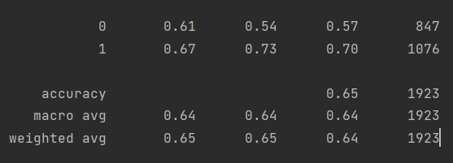
Random Forest :
Random Forest classification was performed using the training data
The test data was used to measure accuracy of the model.
Random forest algorithm is a supervised classification and regression algorithm. This algorithm randomly creates a forest with several trees.
Generally, the more trees in the forest the more robust the forest looks like. Similarly, in the random forest classifier, the higher the number of trees in the forest, greater is the accuracy of the results.

Slide 21
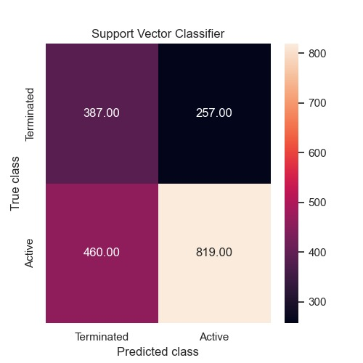
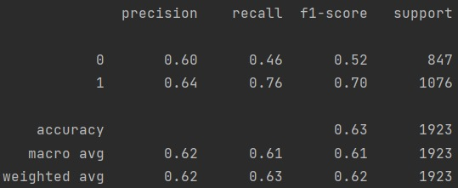
Support Vector Classifier :
SVM is a supervised machine learning algorithm which is mainly used to classify data into different classes
SVM can be used to generate multiple separating hyperplanes such that the data is divided into segments and each segment contains only one kind of data

Slide 22
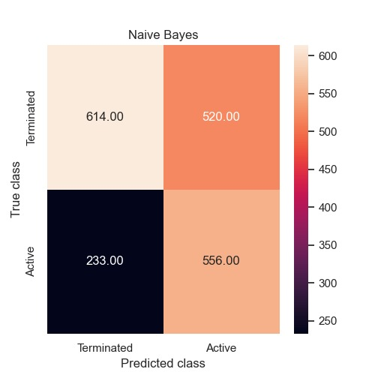
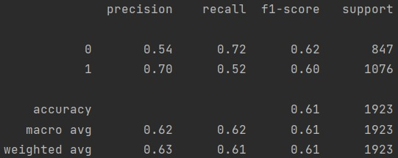
Naive Bayes :
It's a classification technique based on Bayes’ theorem with an assumption of independence among predictors. In simple terms, it assumes that the presence of a particular feature in a class is unrelated to the presence of any other feature.

Slide 23
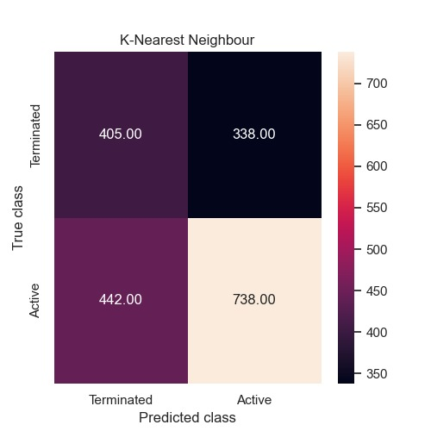
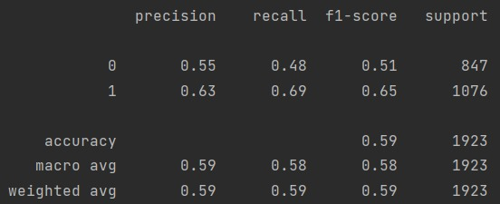
K-Nearest Neighbour :
The k-nearest neighbors (KNN) algorithm is a simple, supervised machine learning algorithm that can be used to solve both classification and regression problems.

Slide 24

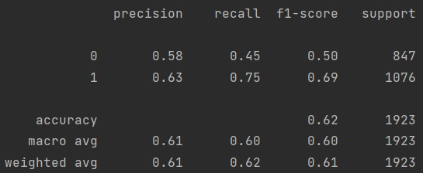
XG Boosting :
XGBoost stands for eXtreme Gradient Boosting
XGBoost is a decision-tree-based ensemble Machine Learning algorithm that uses a gradient boosting framework

Slide 25

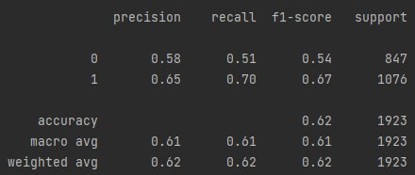
Logistic Regression :
Logistic regression is a statistical model that in its basic form uses a logistic function to model a binary dependent variable
Logistic Regression classification was performed using the training data

Slide 26
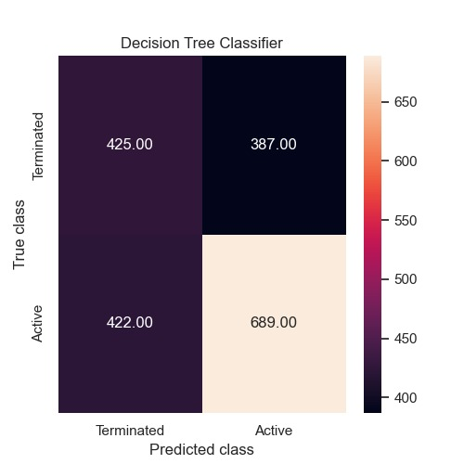
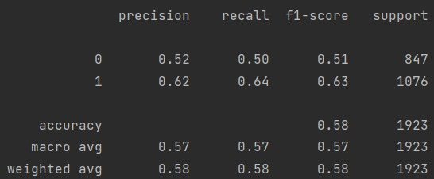
Decision Tree Classifier :
Decision Trees (DTs) are a non-parametric supervised learning method used for classification and regression.
It is a graphical representation of all possible solutions to a decision based on certain conditions. On each step or node of a decision tree, used for classification, we try to form a condition on the features to separate all the labels or classes contained in the dataset to the fullest purity

Slide 27
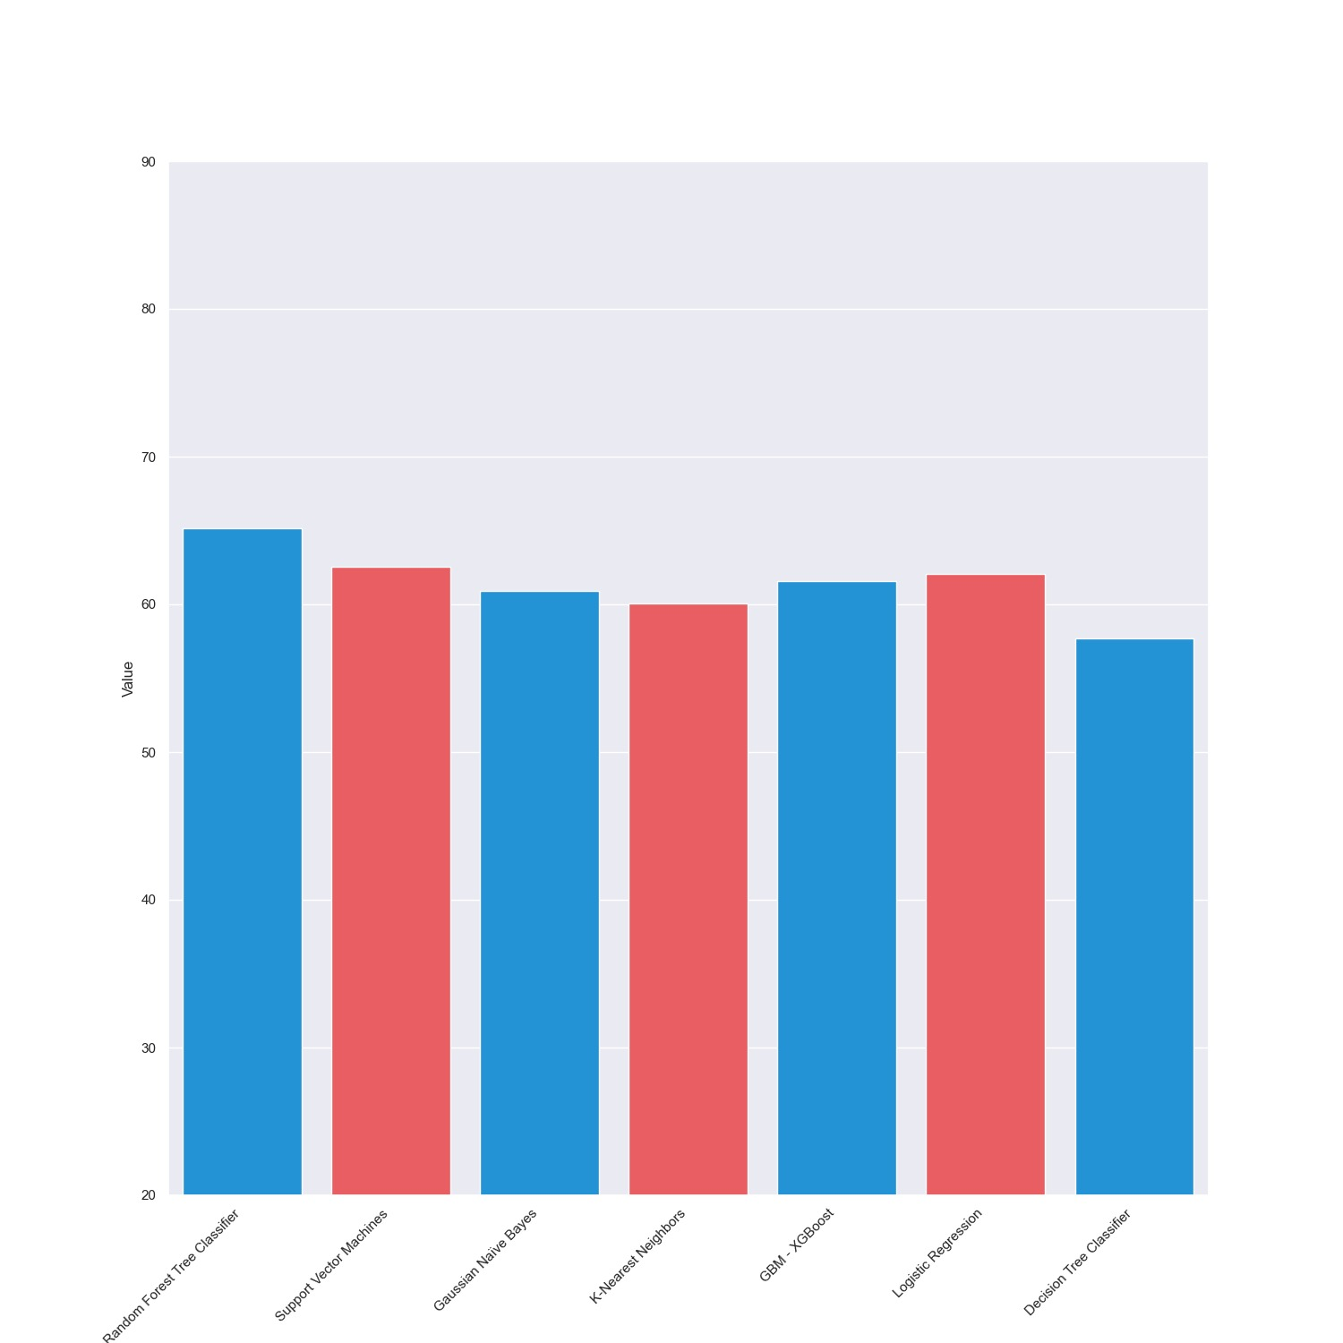
Comparison of Model :

Slide 28
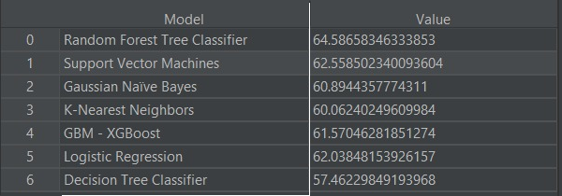
Conclusion:
The Random Forest Tree Classifier model performed better than the other classification models.

Slide 29
Thank you!

